Slide 1
Datenorganisation
Spring School 2022
Part 1

Slide 2
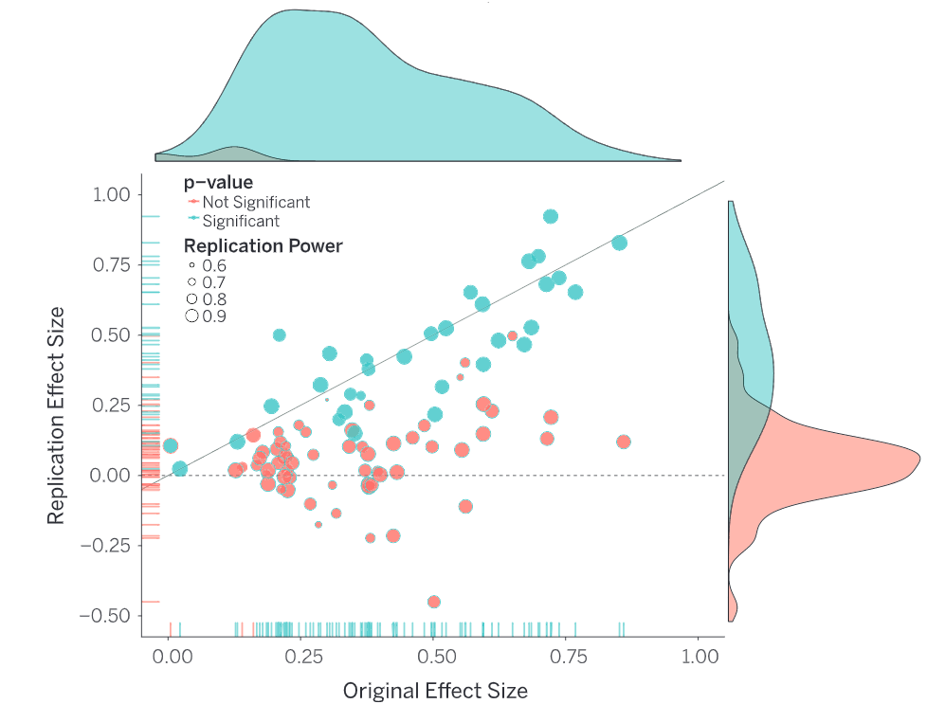
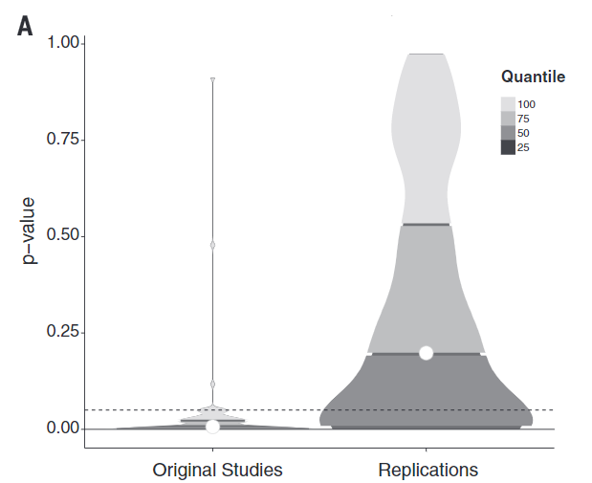
ReplikationsKRISE
Replications of 100 experimental and correlational studies
Evaluate reproducibility using significance, p-values and effect sizes
36% of replications had significant results
47% of original effect sizes were in the 95% CI of the replication effect size
Open Science Collaboration, Science, 2015; Ioannidis , PLOS Medicine, 2005
Notes:
Direct replicationmainly provides evidence for the reliability of aresult

Slide 3
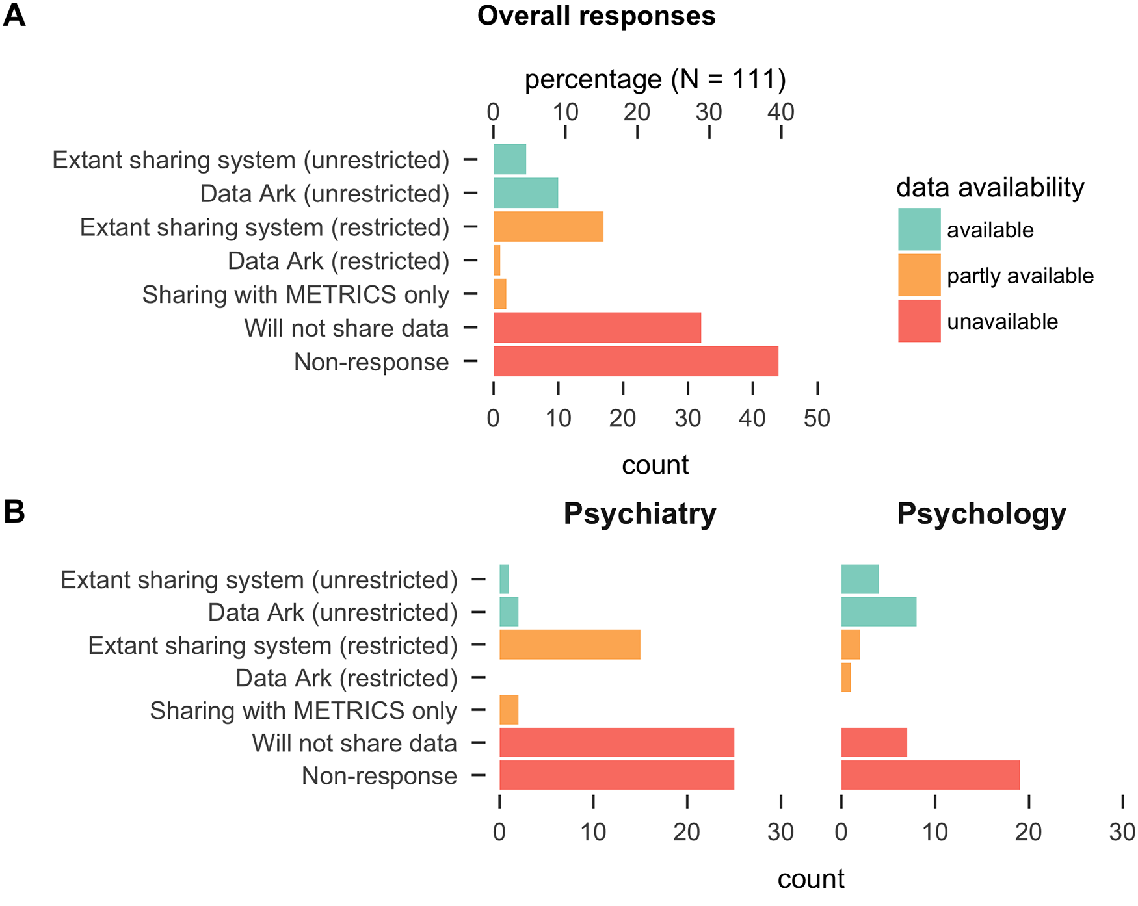
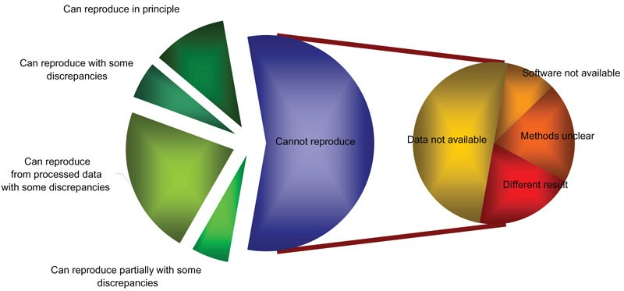
Reproduzierbarkeit von Ergebnissen
Ioannidis, Nature Genetics, 2009; Hardwicke ea., PLoS ONE, 2018

Slide 4




Ziele für heute

Slide 5
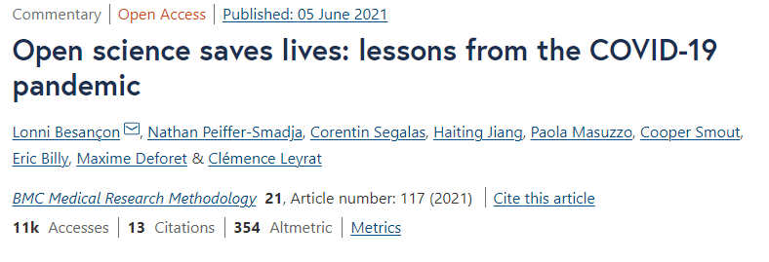
When will‘open science’become simply‘science’
Open access
papers are available for anyone to read without having to pay
Open methodology
allow other researchers to repeat the work and apply it elsewhere
Open source
open and free access to the blueprint of a product (software-source code)
Open peer review
making peer review a collaborative process between authors and reviewer
Open education
open and free availability of educational resource
Open data
releasing both raw and processed data from your experiments, enabling others to analyse it without restrictions
Watson ea., Genome Biology, 2015

Slide 6
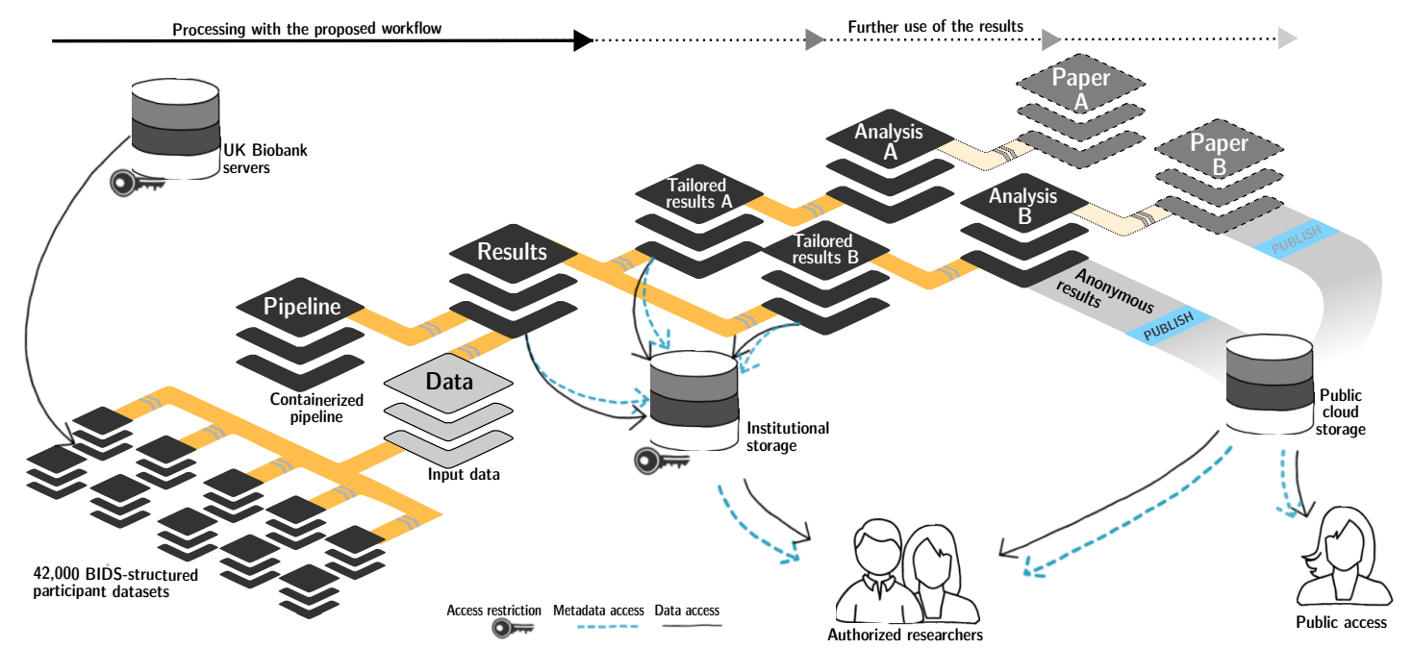
Warum?
Wagner ea., bioRxiv, 2021

Slide 7


Slide 8


Ein Beispiel
Example1/
├─README.tsv
├─dataset_description.json
├─participants.json
├─participants.tsv
└─ sub-001
├─eeg/
└─motion/
├─sub-01_ses-01_task-BalanceTandemStand_motion.tsv
├─sub-01_ses-01_task-BalanceTandemStand_motion.json
└─sub-01_ses-01_task-BalanceTandemStand_channels.tsv
├─ sub-002
└─ sub-003
https://bids-specification.readthedocs.io/en/stable/; https://github.com/bids-standard/bids-examples

Slide 9
BIDS schema: example
participants.json
"age": {
"Description": "age of the participant", "Units": "years" },
"sex": {
"Description": "sex as reported by the participant”, "Levels": {
"M": "male",
"F": “female" }
Example1/
├─README.tsv
├─dataset_description.json
├─participants.json
├─participants.tsv
└─ sub-001
├─ ses-01
├─ ses-02
├─ sub-002
└─ sub-003
participants.tsv
participant_id age sex
sub-001 34 M
sub-002 12 F
sub-003 33 F

Slide 10

To be Findable:
F1. (meta)data are assigned a globally unique and persistent identifier
F2. data are described with rich metadata (defined by R1below)
F3. metadata clearly and explicitly include the identifier of the data it describes
F4. (meta)data are registered or indexed in a searchable resource
To be Accessible:
A1. (meta)data are retrievable by their identifier using a standardized communications protocol
A1.1 the protocol is open, free, and universally implementable
A1.2 the protocol allows for an authentication and authorization procedure, where necessary
A2. metadata are accessible, even when the data are no longer available
To be Interoperable:
I1. (meta)data use a formal, accessible, shared, and broadly applicable language for knowledge representation.
I2. (meta)data use vocabularies that follow FAIR principles
I3. (meta)data include qualified references to other (meta)data
To be Reusable:
R1. meta(data) are richly described with a plurality of accurate and relevant attributes
R1.1. (meta)data are released with a clear and accessible data usage license
R1.2. (meta)data are associated with detailed provenance
R1.3. (meta)data meet domain-relevant community
Wilkinson ea., Scientific Data, 2016
Notes:
To be Findable:
F1. (meta)data are assigned a globally unique and persistent identifier
F2. data are described with rich metadata (defined by R1below)
F3. metadata clearly and explicitly include the identifier of the data it describes
F4. (meta)data are registered or indexed in a searchable resource
To be Accessible:
A1. (meta)data are retrievable by their identifier using a standardized communications protocol
A1.1the protocol is open, free, and universally implementable
A1.2the protocol allows for an authentication and authorization procedure, where necessary
A2. metadata are accessible, even when the data are no longer available
To be Interoperable:
I1. (meta)data use a formal, accessible, shared, and broadly applicable language for knowledge representation.
I2. (meta)data use vocabularies that follow FAIR principles
I3. (meta)data include qualified references to other (meta)data
To be Reusable:
R1. meta(data) are richly described with a plurality of accurate and relevant attributes
R1.1. (meta)data are released with a clear and accessible data usage license
R1.2. (meta)data are associated with detailed provenance
R1.3. (meta)data meet domain-relevant community

Slide 11


Slide 12


Slide 13
Gruppenarbeit (ca. 60 min)
Erhöhen des Truck Faktores eures Experiments
“The number of people on your team who have to be hit with a truck before the project is in serious trouble”
Projektorder von gestern als Grundlage
Aufgaben:
1. Ordner/Daten Struktur entwickeln wo was gespeichert ist
Ordner: skripte, daten, “codebook”
https://psych-transparency-guide.uni-koeln.de/folder-structure.html
2. Auswertungsskript anpassen (single subject & group)

Slide 14
Workflow
Research data management plan
Define metadata
Choose sustainable file formats
Design folder structure
Storing code
Skripts vs. functions
Version control (git)
Storing Files
Individual vs. group
Long vs. wide format
Storing documents
Can I share them?
Proband:innen Info
Ethik

Slide 15

Versionskontrolle

Slide 16
Bibliography
Aarts, A. A., Anderson, J. E., Anderson, C. J., Attridge, P. R., Attwood, A., Axt, J., Babel, M., Bahník, Š., Baranski, E., Barnett-Cowan, M., Bartmess, E., Beer, J., Bell, R., Bentley, H., Beyan, L., Binion, G., Borsboom, D., Bosch, A., Bosco, F. A., … Zuni, K. (2015). Estimating the reproducibility of psychological science. Science, 349(6251). https://doi.org/10.1126/SCIENCE.AAC4716/SUPPL_FILE/AARTS-SM.PDF
Hardwicke, T. E., & Ioannidis, J. P. A. (2018). Populating the Data Ark: An attempt to retrieve, preserve, and liberate data from the most highly-cited psychology and psychiatry articles. PLOS ONE, 13(8), e0201856. https://doi.org/10.1371/JOURNAL.PONE.0201856
Ioannidis, J. P. A. (2005). Why Most Published Research Findings Are False. PLOS Medicine, 2(8), e124. https://doi.org/10.1371/JOURNAL.PMED.0020124
Ioannidis, J. P. A., Allison, D. B., Ball, C. A., Coulibaly, I., Cui, X., Culhane, A. C., Falchi, M., Furlanello, C., Game, L., Jurman, G., Mangion, J., Mehta, T., Nitzberg, M., Page, G. P., Petretto, E., & van Noort, V. (2009). Repeatability of published microarray gene expression analyses. Nature Genetics 2009 41:2, 41(2), 149–155. https://doi.org/10.1038/ng.295
Wagner, A. S., Waite, L. K., Wierzba, M., Hoostaedter, F., Waite, A. Q., Poldrack, B., Eickhoo, S. B., & Hanke, M. (2021). FAIRly big: A framework for computationally reproducible processing of large-scale data. https://doi.org/10.1101/2021.10.12.464122
Watson, M. (2015). When will “open science” become simply “science”? Genome Biology, 16(1), 1–3. https://doi.org/10.1186/S13059-015-0669-2/METRICS
Wilkinson, M. D., Dumontier, M., Aalbersberg, Ij. J., Appleton, G., Axton, M., Baak, A., Blomberg, N., Boiten, J. W., da Silva Santos, L. B., Bourne, P. E., Bouwman, J., Brookes, A. J., Clark, T., Crosas, M., Dillo, I., Dumon, O., Edmunds, S., Evelo, C. T., Finkers, R., … Mons, B. (2016). The FAIR Guiding Principles for scientific data management and stewardship. Scientific Data 2016 3:1, 3(1), 1–9. https://doi.org/10.1038/sdata.2016.18

